Slide 1
Cognizant and Aston Martin Formula 1 Gen-AI idea-thon
I / AM Pulse
Start your engine. Earn your experience
F1-nctional Intelligence:
Yash Sethi
Nehal Joshi
Sahil Negii
Damaris Arauco

Slide 2
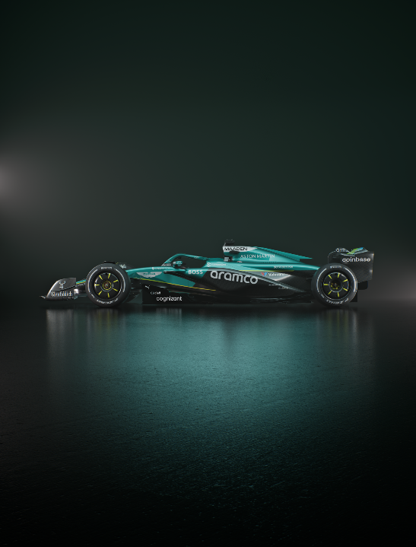

Agenda
The Challenge
Persona
I/AM Pulse
Engagement into Loyalty
App Demo
Social Activation Strategy
Business & Market Impact
Feasibility & Roadmap
Elevator Pitch

Slide 3
The Challenge
How can AMF1 use Gen AI to meet fan expectations, boost merchandise sales, and strengthen its global brand through social media and lifestyle branding?
32
42%
1/3
1/3
Average fan age
of fans are female
joined in the last 5 years
of TV viewers are under 35
WITH MERCH ON THE RISE, AMF1 CAN ELEVATE FAN ENGAGEMENT BY REWARDING AND PERSONALIZING EXPERIENCES ACROSS DIGITAL AND TRACKSIDE TOUCHPOINTS.

Slide 4
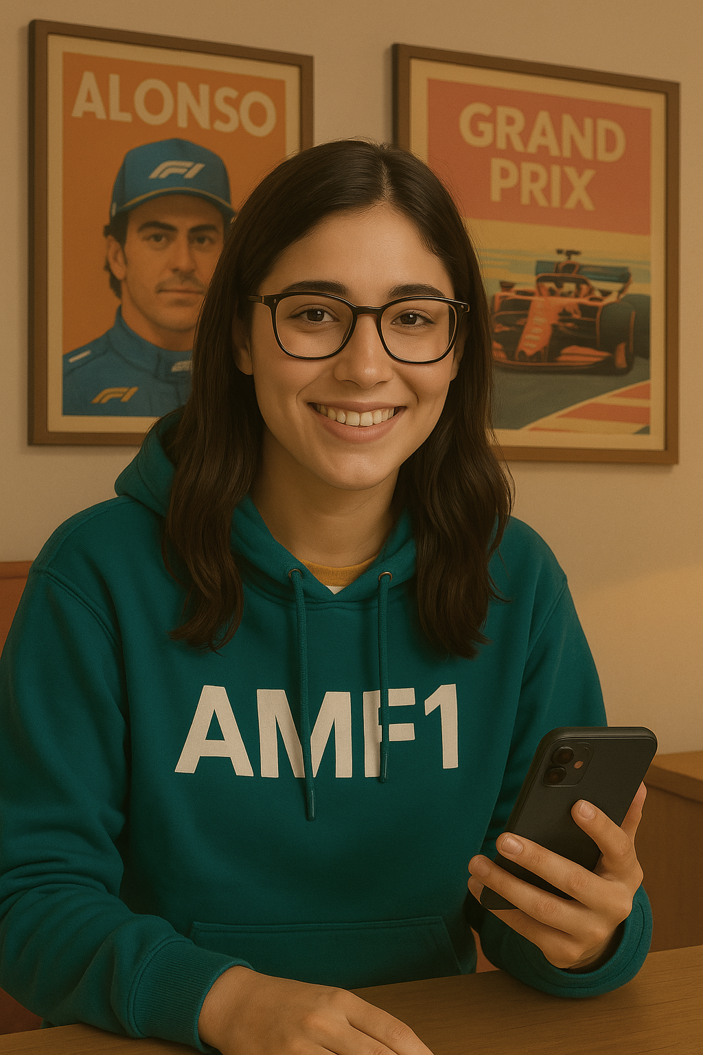
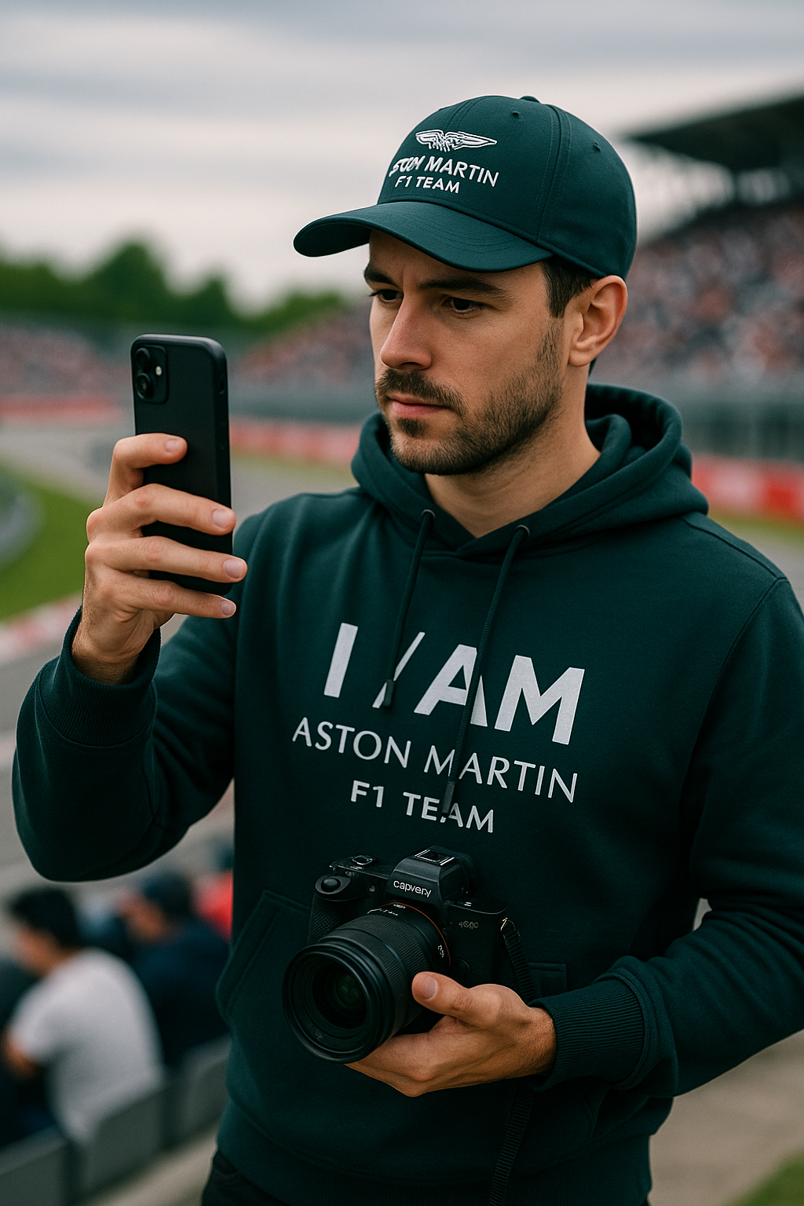
Two Fans, One Platform
REMOTE FAN
ON-SITE FAN
Name: Lucía
Age: 24
Location: Argentina
Follows AMF1 via: Instagram, Twitter (X), TikTok
Name: Julien
Age: 30
Location: Canada
Follows AMF1 via: Instagram, YouTube, TikTok
“I might be far from the track, but I never miss a moment”
“Being in the stands is electric. I just wish that energy lasted longer than one weekend”

Slide 5
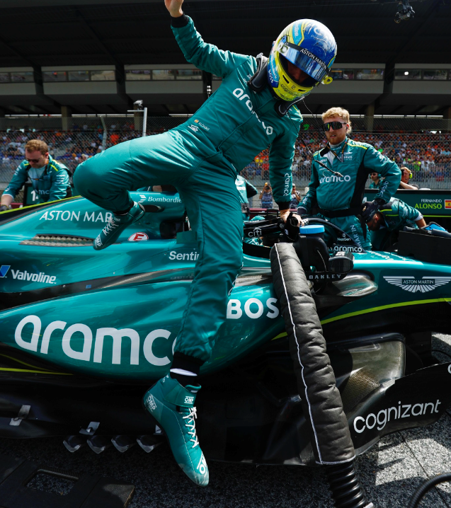
I/AM PULSE Powered by Gen-AI
Start your engine.
Earn your experience.
A fan-centric app that rewards every interaction — from quizzes to merch to race attendance — with personalized experiences, exclusive drops, and a sense of belonging.

Slide 6
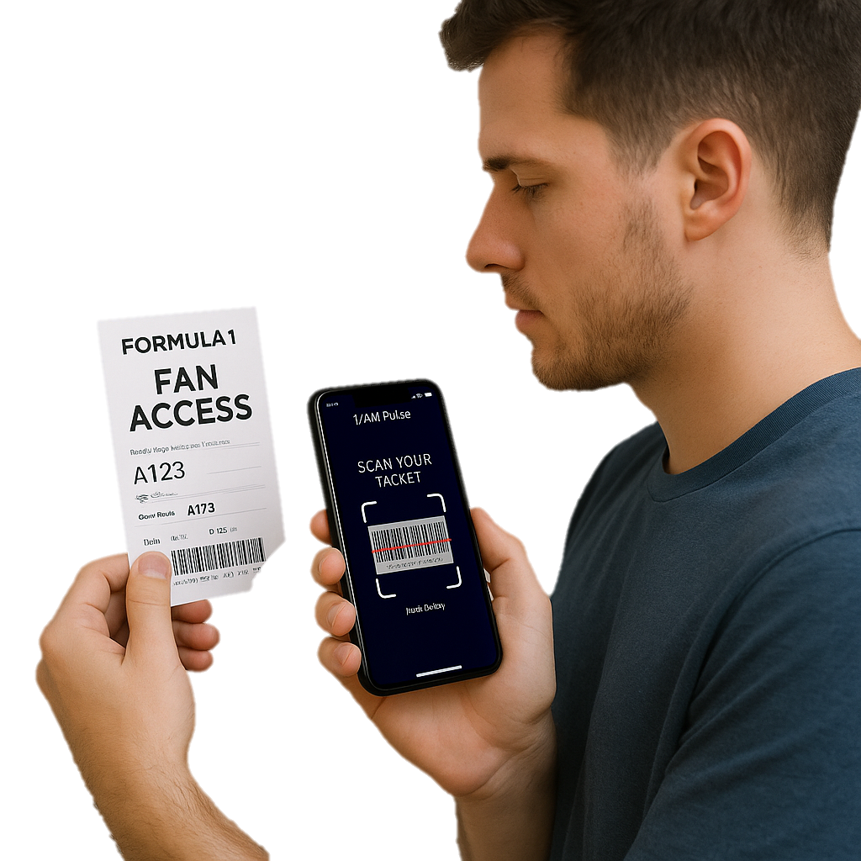
HOW IT WORKS
FANS CAN:
Register their tickets
Take in-app quizzes that reveal their interests
Engage with AMF1 content (watch, post, share)
IN RETURN:
Earn points
Unlock rewards like exclusive drops or fan meetups
Get personalized merch
Why this matters?
✅Feel recognized and included
✅Boost merch sales
✅Builds a community that lasts beyond race day

Slide 7
How I/AM Pulse Turns Engagement into Loyalty
INTERACTION
DATA COLLECTED
GEN AI INSIGHTS
POINTS EARNED
TAILORED REWARDS
Registering race tickets
Taking quizzes about interests
Sharing race-day content
Fan preferences
Event activitiy
Behaviour patterns across regions
AR try-ons before buying
Unlock trends across fan base
Suggest data-backed collabs
The more they participate, the more value they unlock
Fuel fan progression inside the app
Exclusive merch drops
Personalized items/content
Loot Crate
From clicks to cheers — every action fuels personalization

Slide 8
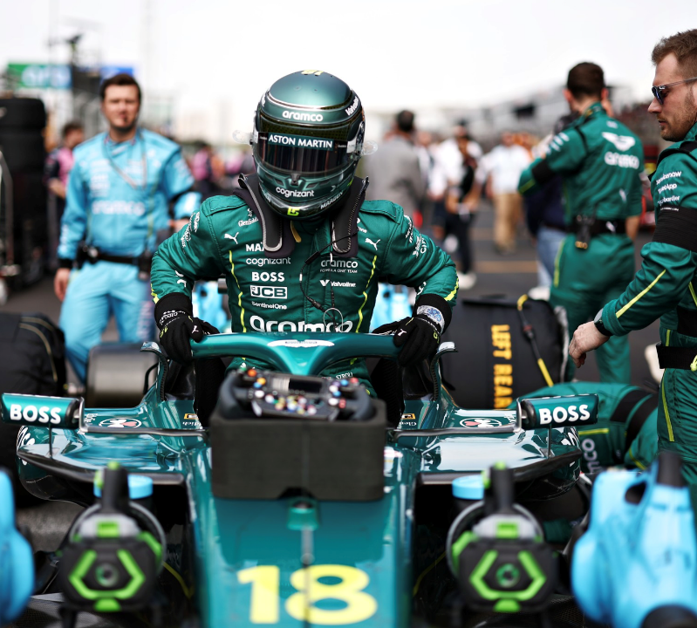


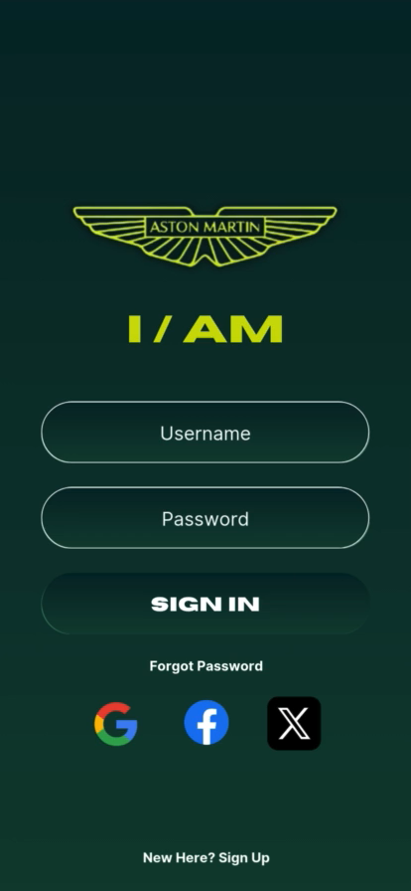
APPLICATION DEMO

Slide 9
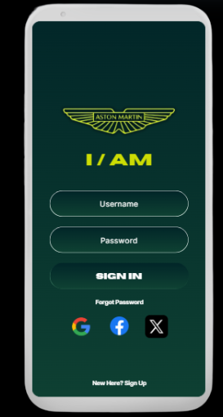
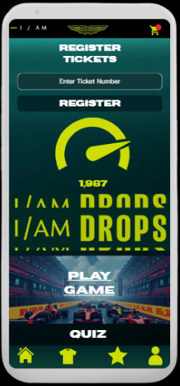
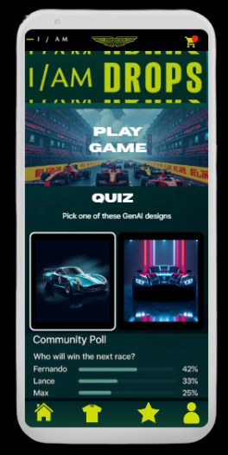
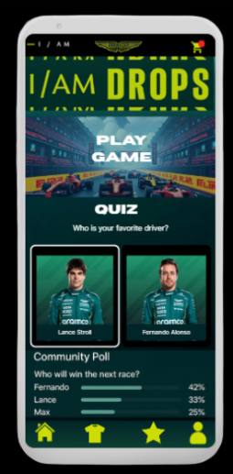
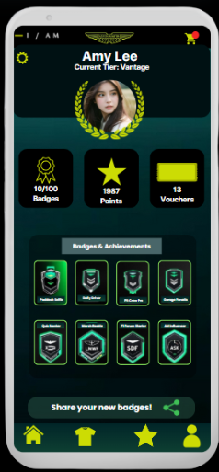
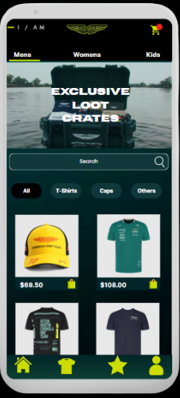
APPLICATION MOCK-UP
Sign-up
Register Ticket
Quiz Page 1
Quiz Page 2
Profile Page
Buy Merch

Slide 10
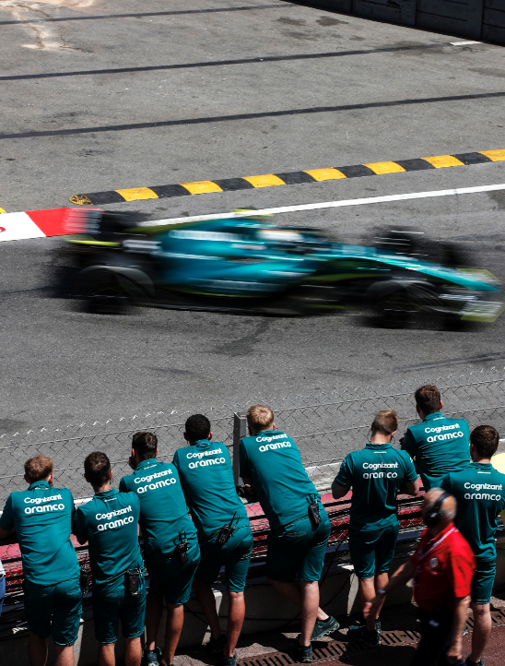
LOYALTY TIERS
IGNITION
Entry-level tier. Access to basic content—news, race results, and wallpapers
VELOCITY
Includes behind-the-scenes content, driver interviews, and fan polls
AERO
Offers exclusive live streams, strategy insights, and race-day breakdowns
VANTAGE
Mid-high tier, named after the iconic Aston Martin Vantage. Includes early access to merch drops, AR car experiences, and virtual meetups
PIT LANE ELITE
VIP content, such as direct team Q&As, engineering briefings, and live garage cams during qualifying

Slide 11
SOCIAL ACTIVATION STRATEGY
CATEGORY
HOW IT WORKS
EXAMPLES
Hyper - personalized campaigns
App quizzes reveal fan interests
AI clusters fans and tailor social content
Pandora x AMF1 Capsule
Brand Ambassadors
App quizzes reveal fan interests
AI clusters fans and tailor social content
“Post Your Fit” Campaign
Rewards & Activations
Engagement on social = Early unlocks
Connects in-app rewards with fan hype cycles
Montreal GP Fan Loot Crate
Activating fans with data-driven, shareable moments

Slide 12
Business & Market Impact
BUSINESS IMPACT
SUCCESS METRIC
Increase merch sales through exclusives
Increase merch sales through exclusives
Personalized bundles and product suggestions
Average Order Value (AOV)
increase per user
Monetize fan preferences through smarter brand collabs
Number of quizzes completed
% of users engaging with collab
Strengthen loyalty through gamified rewards and recognition
Points redeemed per user
Repeat logins / active users retention
Each point earned leads to stronger fans, smarter insights and higher revenue

Slide 13
FEASIBILITY & ROADMAP
FEATURES
KEY OUTCOME
RELEVANT TOOLS
PHASE 1:
MVP LAUNCH
Ticket registration
Fan interest quizzes
Special loyalty tier
Validate fan interest
Collect zero-party data
FastAPI,
PostgreSQL
PHASE 2:
FAN EXPERIENCE
AR try-on for merch
Fan forums
Exclusive drops
Increase engagement
Build emotional connection
Google Virtual Try-on
Firebase Database
Shopify (exclusive drops)
PHASE 3:
FULL INTEGRATION
Personalized rewards
Social activation and brand collabs
Loyalty Tiers
Monetize fan engagement
Scale globally with data-driven loyalty
Gen-AI personalization
Instagram/TikTok APIs
All tools are existing and scalable, no need to build from scratch to bring it to life

Slide 14
ELEVATOR PITCH: I/AM PULSE
THE IDEA
A Gen AI app that turns fan interactions into personalized rewards and merch
HOW IT WORKS
Fans scan tickets, take quizzes, and share content → we collect zero-party data
WHY IT WORKS
Gen AI spots trends, segments fans, and recommends content and products
THE RESULT
Fans unlock exclusive drops, tailored perks, and feel recognized year-round
WHAT SETS US APART
Engagement becomes insight, insight drives loyalty, loyalty fuels revenue

Slide 15
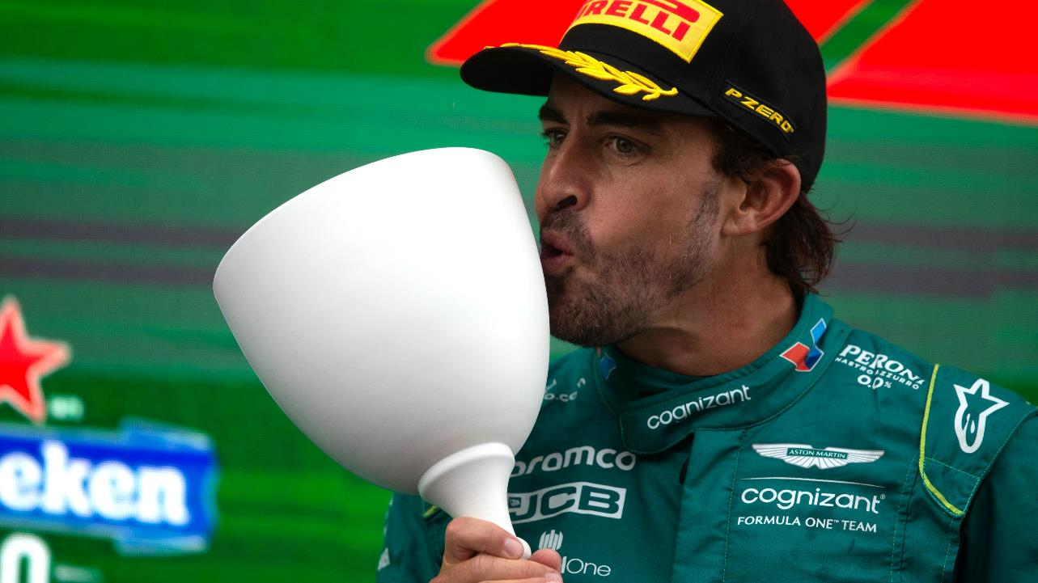
Q&A
Yash Sethi, Nehal Joshi, Sahil Negi, Damaris Arauco

Slide 16
Appendix

Slide 17
Estimated Fanbase Growth Projections by Strategy
Strategy Category | Key Growth Mechanism | Primary Metrics Impacted | Estimated Quantitative Impact (Range/Qualitative)
Community-Driven Engagement & Co-Creation | User-Generated Content (UGC), Interactive Features | Follower Growth Rate, Engagement Rate, Social Media Interactions, UGC Volume, Brand Advocacy | High monthly follower growth (e.g., 1-5% on Instagram, 0.5-3% on Facebook); Potential to increase engagement rates by 50-100% (based on smaller profile benchmarks); Significant increase in social media shares and user-generated content volume.
Always-On Multichannel Content | Diverse Content Formats, Consistent Presence | Site Traffic Volume, Pageviews, Conversion Rate, Organic Traffic Growth, Brand Awareness | Potential to increase blog traffic by up to 2,000% (with better content); Enhanced brand visibility across platforms; Sustained audience connection beyond single product launches.
Monetization & Creator Economy Alignment | Direct Creator Monetization (Subscriptions, Tipping), Microtransactions | Customer Lifetime Value (LTV), Retention Rates, Creator Loyalty, Fan Investment | Potential to double LTV and retention rates (loyal customers spend 6x more than casual fans); Increased creator output and quality due to direct support.
Integrated Digital Experiences & Tiered Memberships | Exclusive Access, Loyalty Programs, OTT Services | Fandom Size, Business Revenue, Customer Retention, Brand Loyalty | Potential for exponential business growth, mirroring large-scale case studies like NBA's business doubling; 5% increase in retention can boost profits by up to 95%.

